Slide 1


Real-Time Attack Detection System for CPS
A Python-based, real-time solution for robust cybersecurity across traditional IT networks and critical Cyber-Physical Systems.

Slide 2


Protecting Our Digital and Physical Worlds
Modern infrastructures rely on interconnected IT and Cyber-Physical Systems (CPS). Securing these environments from evolving threats requires a sophisticated, real-time defense strategy. Our system bridges this gap, offering comprehensive protection.
Traditional IT Networks
Cyber-Physical Systems (CPS)
Securing enterprise data, communications, and IT infrastructure.
Defending critical infrastructure, industrial control, and operational technologies.

Slide 3





Comprehensive System Capabilities
This Python-based system is engineered to provide an all-encompassing defense, from real-time monitoring to automated threat neutralization and intuitive visualization.
Real-Time Monitoring
Multi-Attack Detection
Instant Alerting
Captures network traffic, analyzes system logs, and monitors processes.
Identifies over 20 types of cyber threats, including IT and CPS-specific attacks.
Notifies users via desktop, Telegram, and a centralized dashboard.
Automated Defense
Modern Web Dashboard
Initiates active counter-measures to block and neutralize threats.
Provides intuitive visualization and management of security events.

Slide 4

Key Feature: Advanced Monitoring
Our system provides granular visibility into your environment, ensuring no critical activity goes unnoticed. Monitoring extends to both traditional network layers and specialized industrial protocols.
Network Packet Capture
Leverages Scapy for deep inspection of network traffic.
System & Log Monitoring
Tracks activities across Linux and Windows systems for anomalies.
Process Monitoring
Keeps an eye on running processes to detect malicious execution.
Industrial Protocol Monitoring
Specialized support for Modbus, DNP3, OPC-UA, IEC 61850, and BACnet.

Slide 5





Key Feature: Multi-Attack Detection
With capabilities to detect over 20 distinct attack types, our system offers a robust defense against a wide spectrum of cyber threats, from common IT exploits to complex CPS attacks.
DDoS / Flooding
Identifies ICMP floods and other packet-based denial-of-service attempts.
Port Scanning
Detects unauthorized scanning activities aimed at discovering open ports.
Brute Force Login
Flags repeated failed login attempts indicative of brute-force attacks.
Intrusion Attempts
Recognizes malicious commands, SQL injections, and other intrusion vectors.
CPS Attacks
Specialized detection for unauthorized PLC access, timing anomalies, and replay attacks affecting industrial operations.

Slide 6
Key Feature: Advanced Alerting & Active Defense
Timely notifications and automated responses are crucial for minimizing damage. Our system ensures immediate awareness and proactive threat neutralization.
Alert System
Active Defense (IPS)
Desktop Notifications
Auto-Block Malicious IPs
Immediate pop-up alerts for critical events.
Automatically isolates threatening IP addresses.
Telegram Alerts
Kill Malicious Processes
Secure, instant messages to designated personnel.
Terminates harmful software executions.
Dashboard Notifications
Lock User Accounts
Centralized alerts within the web interface.
Secures compromised user access.
Log File Records
Disable Interfaces & Restart Services
Detailed records for forensic analysis and compliance.
(Optional) Critical actions for containment and recovery.

Slide 7
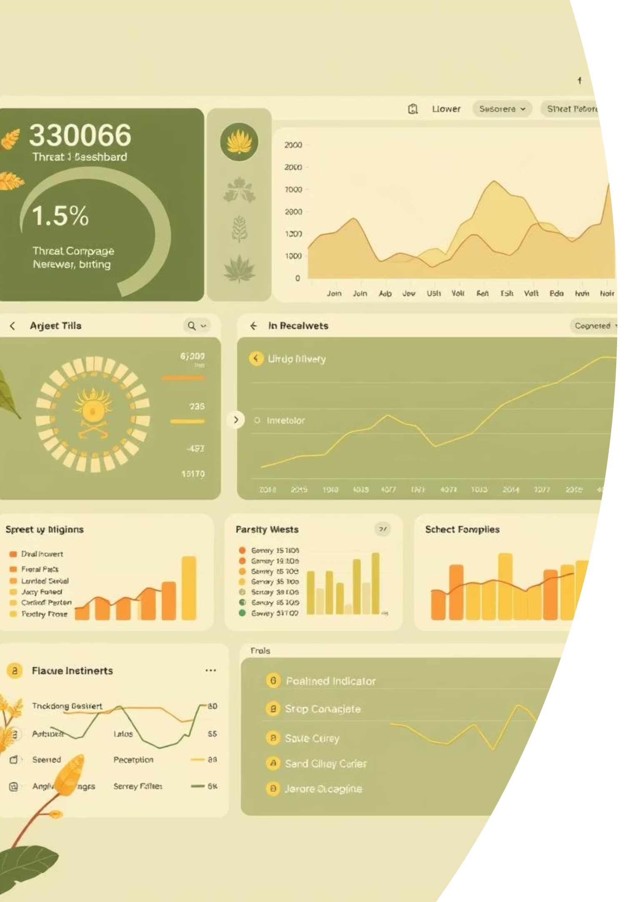
Key Feature: Modern Web Dashboard
Gain real-time insights and complete control over your security posture with an intuitive, visually rich web interface designed for clarity and efficiency.
The dashboard features a stunning glassmorphism UI, providing a modern and engaging user experience for security professionals.
Real-time Visualization
Dynamic display of ongoing attacks and system metrics.
Performance Graphs
CPU, memory, and network utilization at a glance.
Attack Timeline
Chronological view of all security incidents.
Filtering & Search
Efficient tools for investigating specific events.

Slide 8







System Architecture Overview
Our modular architecture ensures robustness, scalability, and ease of maintenance, with distinct components for each critical function.
Monitoring
Detection Engine
Alerts
Active Defense
Monitor/
Packet, log, process, industrial protocol.
Detectors/
DDoS, port scan, brute force, intrusion, CPS, Modbus.
Alerts/
Desktop, Telegram.
Auto_response/
Active defense mechanisms.
Dashboard/
Streamlit web UI for visualization.
Main.py
The core orchestrator of all modules.

Slide 9
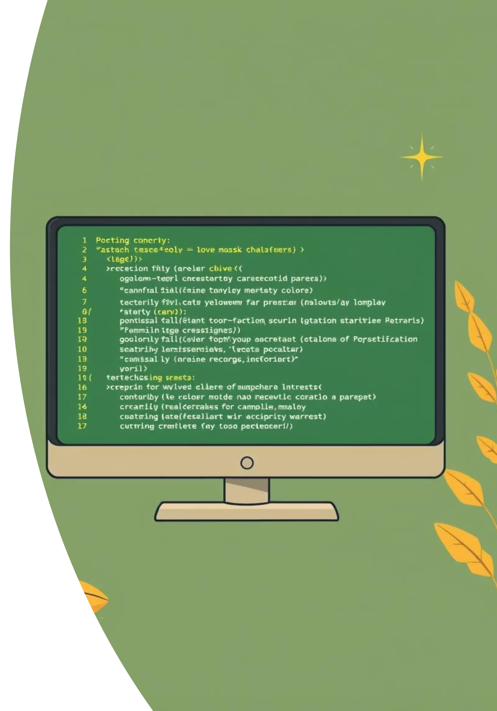
Underlying Technologies & Setup
Built on a foundation of powerful, open-source technologies, our system offers flexibility and high performance. Deployment is straightforward, catering to both Windows and Linux/macOS environments.
Core Technologies
Installation & Configuration
Python: The primary programming language.
Install Python dependencies: pip install -r requirements.txt
Scapy: For robust packet manipulation and analysis.
Install packet capture driver:
Streamlit & Plotly: For interactive web dashboard and visualizations.
Windows: Npcap required
Linux/macOS: libpcap
Pandas: For efficient data handling and analysis.
Configure config.json for custom settings.
psutil, watchdog, plyer: For system monitoring and desktop alerts.
Run the main system: python main.py
Start the dashboard: streamlit run dashboard/app.py

Slide 10
Tailored Security: Customizable Configuration
Adapt the system precisely to your environment's unique needs, ensuring optimal performance and protection.
Detection Thresholds
CPS Protocol Settings
Alerting Preferences
Fine-tune sensitivity for various attack types.
Adjust parameters for industrial control system monitoring.
Manage Telegram and other notification options.
Auto-Response Actions
IP Whitelist/Blacklist
Define automated defense measures (blocking, killing processes).
Specify trusted and untrusted network addresses.

